Slide 1

Chapter 3: Software Life Cycle Models and Processes

Slide 2
Contents
1. SOFTWARE LIFE CYCLE MODELS
2. DESIGN VERIFICATION AND VALIDATION
3. SOFTWARE LIFE CYCLE ACTIVITIES
4. SOFTWARE TESTING

Slide 3
1. Software life cycle models
A software life cycle is a phased approach to developing software, with specific deliverables and milestones within each phase. A software life cycle model is an abstraction of the software development process, which is convenient to use for planning purposes.

Slide 4
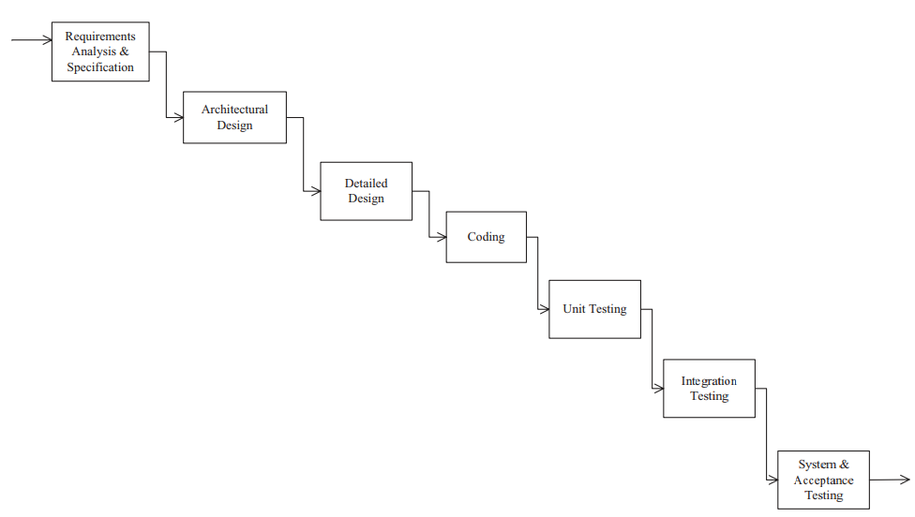
1.1. Waterfall Life Cycle Model

Slide 5
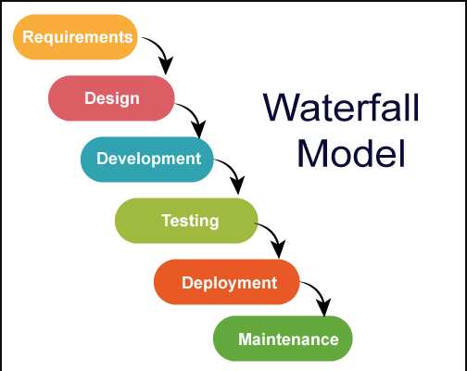
1.1 Waterfall Life Cycle Model
The waterfall model was the earliest software life cycle model to be widely used
The waterfall model is an idealized process model in which each phase is completed before the next phase is started, and a project moves from one phase to the next without iteration or overlap.

Slide 6
1.2 Limitations of the Waterfall Model
Does not show iteration in software life cycle
Does not show overlap between phases
Software requirements are tested late in life cycle
Operational system available late in life cycle

Slide 7
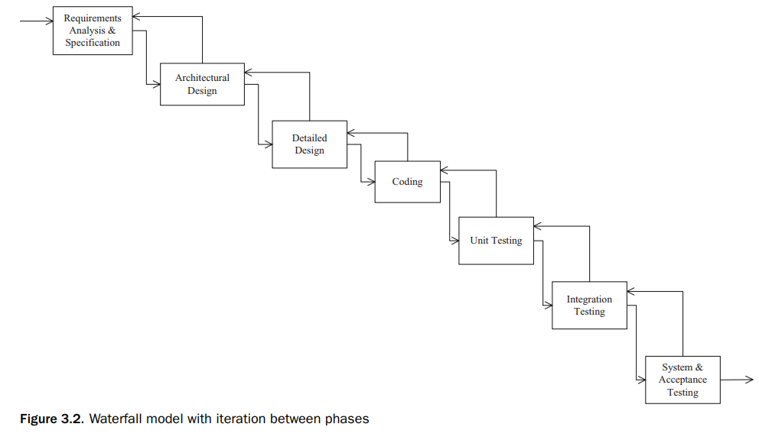
1.2 Limitations of the Waterfall Model
In practice, however, some overlap is often necessary between successive phases of the life cycle, as well as some iteration between phases when errors are detected

Slide 8
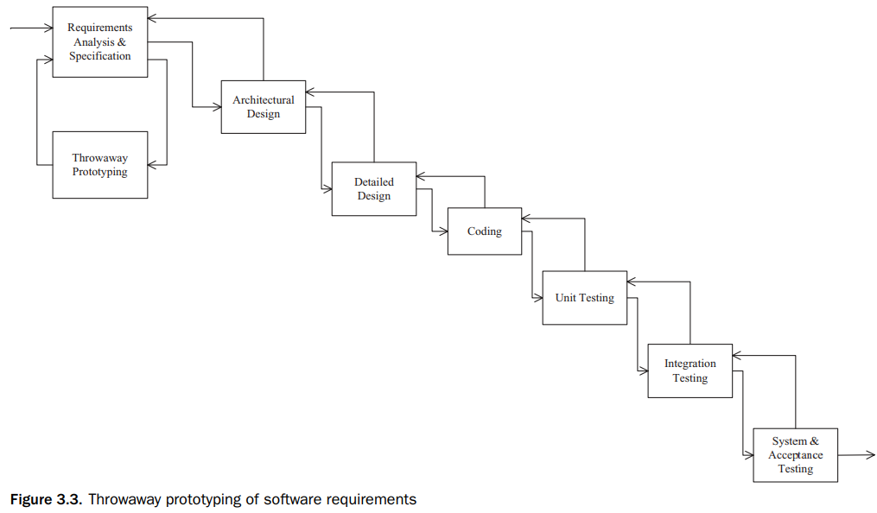
1.3 Throwaway Prototyping
Throwaway prototypes can be used to help clarify user requirements. This approach is particularly useful for getting feedback on the user interface and can be used for systems that have a complex user interface.
The biggest problem it helped overcome was the communications barrier that existed between the users and the developers.
Throwaway prototyping of requirements

Slide 9
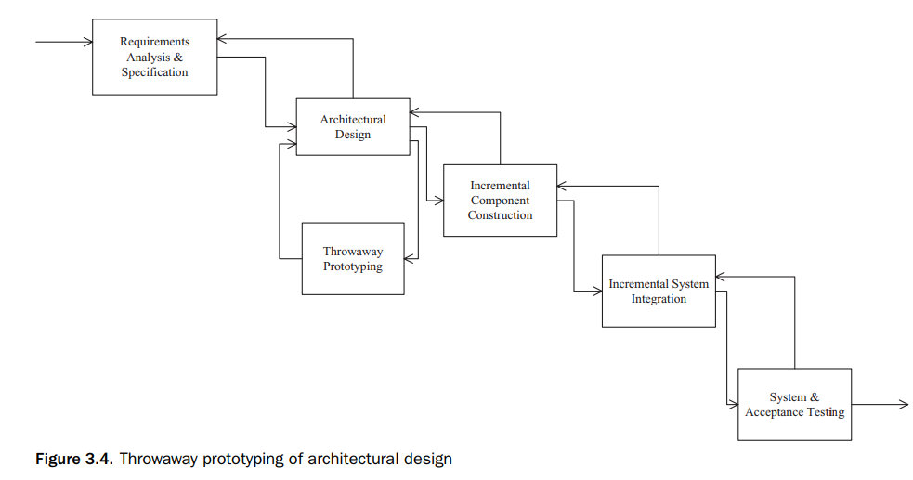
1.3 Throwaway Prototyping
Throwaway prototypes can also be used for experimental prototyping of the design
﻿﻿Throwaway prototyping of architectural design

Slide 10
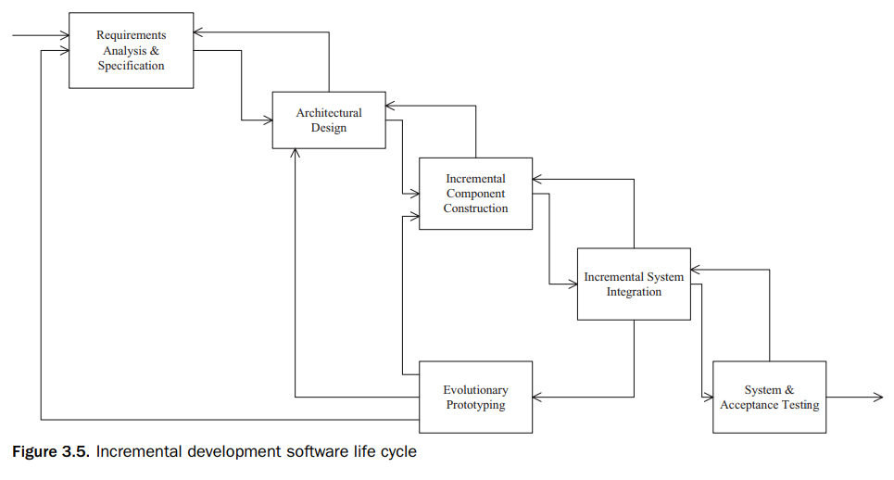
1.4 Evolutionary Prototyping by Incremental Development
The evolutionary prototyping approach is a form of incremental development in which the prototype evolves through several intermediate operational systems into the delivered system.
One objective of the evolutionary prototyping approach is to have a subset of the system working early, which is then gradually built on.

Slide 11
1.5 Combining Throwaway Prototyping and Incremental Development
With the incremental development life cycle model approach, a working system in the form of an evolutionary prototype is available significantly earlier than with the conventional waterfall life cycle.
It is also possible to combine throwaway prototyping and incremental development. A throwaway prototyping exercise is carried out to clarify the requirements. After the requirements are understood and a specification is developed, an incremental development life cycle is pursued. After subsequent increments, further changes in requirements might be necessary owing to changes in the user environment.

Slide 12
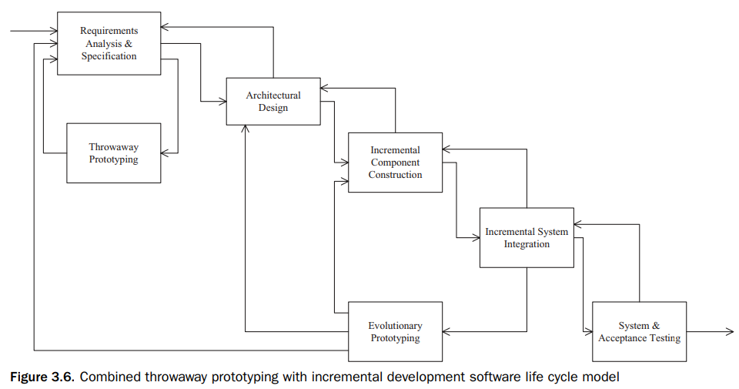
1.5 Combining Throwaway Prototyping and Incremental Development

Slide 13
1.6 Spiral Model
The spiral model is a risk-driven process model originally developed by Boehm (1988) to address known problems with earlier process models of the software life cycle.

Slide 14
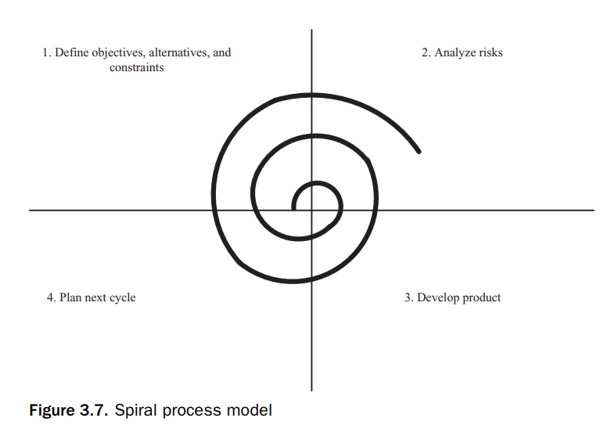
1.6 Spiral Model
In the spiral model, the radial coordinate represents cost, and the angular coordinate represents progress in completion of a cycle of the model. It consists:
1. Define objectives, alternatives, and constraints. Detailed planning for this cycle: identify goals and alternative approaches to achieving them. 2. Analyze risks. Detailed assessment of current project risks; plan activities to be performed to alleviate these risks. 3. Develop product. Work on developing product, such as requirements analysis, design, or coding. 4. Plan next cycle. Assess progress made on this cycle and start planning for next cycle.

Slide 15
1.7 Unified Software Development Process
The Unified Software Development Process (USDP) (Jacobson et al. (1999)) is a use case–driven software process that uses the UML notation. It is also known as the Rational Unified Process (RUP) (Kroll and Kruchten 2003; Kruchten 2003).
USDP/RUP is a popular process for UML-based software development.
The USDP consists of five core workflows and four phases and is iterative,
An artifact is defined as a piece of information that is produced, modified, or used by a process
A workflow is defined as a sequence of activities that produces a result of observable value.
A phase is defined as the time between two major milestones during which a well-defined set of objectives is met, artifacts are completed, and decisions about whether to move on to the next phase are made.

Slide 16
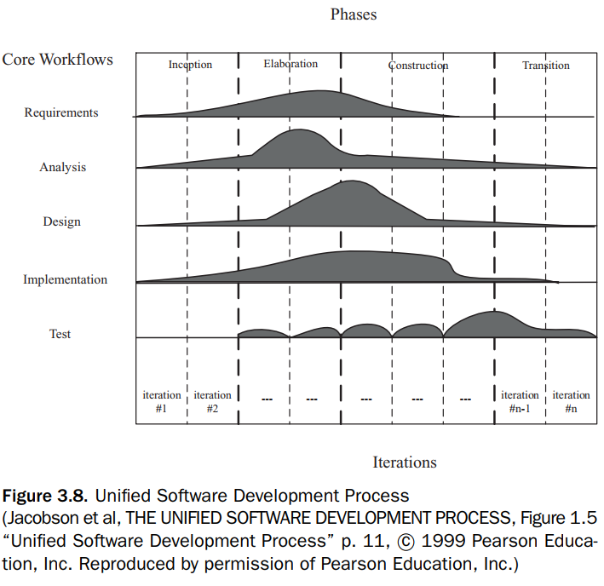
1.7 Unified Software Development Process

Slide 17
1.7 Unified Software Development Process
Each cycle goes through all four phases and addresses the development of a core workflow. 1. Requirements. The product of the requirements workflow is the use case model. 2. Analysis. The product of the analysis workflow is the analysis model. 3. Design. The products of the design workflow are the design model and the deployment model. 4. Implementation. The product of the implementation workflow is the implementation model. 5. Test. The product of the test workflow is the test model

Slide 18
1.7 Unified Software Development Process
Like the spiral model, the USDP is a risk-driven process. The life cycle phases of the USDP are as follows: 1. Inception. During the inception phase, the seed idea is developed to a sufficient level to justify entering the elaboration phase. 2. Elaboration. During the elaboration phase, the software architecture is defined. 3. Construction. During the construction phase, the software is built to the point at which it is ready for release to the user community. 4. Transition. During the transition phase, the software is turned over to the user community.
Inception: This phase focuses on defining the project’s scope and objectives. Key activities include identifying key system functionality, estimating costs, and assessing risks

Slide 19
2. DESIGN VERIFICATION AND VALIDATION
The goal of software validation is to ensure that the software development team “builds the right system,” that is, to ensure that the system conforms to the user’s needs.
The goal of software verification is to ensure that the software development team “builds the system right,” that is, to ensure that each phase of the software system is built according to the specification defined in the previous phase.

Slide 20
2.1 Software Quality Assurance
Software quality assurance is a name given to a set of activities whose goal is to ensure the quality of the software product.
Software verification and validation are important goals of software quality assurance
Throwaway prototyping can be used for validation of the system (before it is developed) against the user requirements, to help ensure that the team “builds the right system,”
Software technical reviews can help considerably with software verification and validation.
Verification is to ensure that the design conforms to the software requirements specification.

Slide 21
2.2 Performance Analysis of Software Designs
Analyzing the performance of a software design before implementation is necessary to estimate whether the design will meet its performance goals. If potential performance problems can be detected early in the life cycle, steps can be taken to overcome them.
Approaches for evaluating software designs: queuing models, simulation models, Petri nets, real-time scheduling theory.

Slide 22
3. Software life cycle activities
Requirements Analysis and Specification
In this phase, the user’s requirements are identified and analyzed. The requirements of the system to be developed are specified in a Software Requirements Specification (SRS).
Its goal is to provide a complete description of what the system’s external behavior is without describing how the system works internally
Architectural Design
A software architecture (Bass, Clements, and Kazman 2003; Shaw and Garlan 1996) separates the overall structure of the system, in terms of components and their interconnections, from the internal details of the individual components.
During this phase, the system is structured into its constituent components and the interfaces between these components are defined.

Slide 23
3. Software life cycle activities
Detailed Design
During the detailed design phase, the algorithmic details of each system component and Internal data structures are defined.
Coding
During the coding phase, each component is coded in the programming language selected for the project

Slide 24
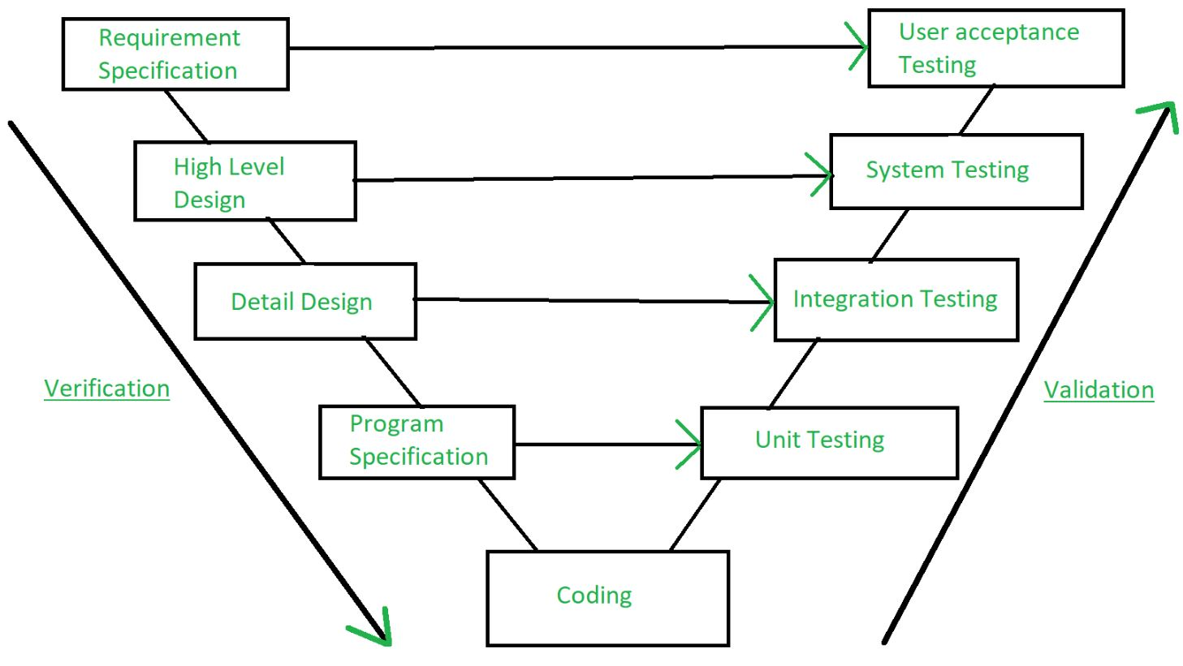
4. Software testing

Slide 25
4. Software testing
Unit Test
Integration
System Test
UAT
Functional testing
Load testing
Stress testing
Volume testing
Carries out by the end users
Tests on individual components
Uses test-coverage criteria
Involves combining tested components into progressively complex grouping
UAT: carries out by end-users!

